Slide 1

Artificial Intelligence Readiness Score: Extending Model for Enterprise AI Adoption
A Doctoral Research Project Proposal – Scholar Practitioner Model
Fabio Correa Touro University Worldwide Doctorate of Business Administration DBA712 - Doctoral Research Project Proposal
Committee: Chair: Dr. Karina Kasztelnik Faculty Member: Dr. Jerome Jones Faculty Member: Dr. Donna Day
October 22, 2025
Notes:
https://app.centiment.co/preview/471bc02e-aeac-4ae3-9fb9-b58a4a12c573

Slide 2

The Business Problem and Motivation for this Project
The A.I. Adoption Paradox
Widespread Adoption
Limited Value Realization
AI use has exploded across enterprises:
Yet measurable impact remains elusive:
55% adoption in 2023
Only 5% achieve measurable ROI
72% adoption in 2024
Just 1% consider themselves "AI mature"
76% adoption by early 2025
74% struggle to scale beyond pilots
Nearly every major organization now uses AI in at least one business function (McKinsey & Company, 2023–2025; International Data Center Authority, 2025).
The technology is ready—but organizations are not (Boston Consulting Group, 2024, 2025; McKinsey & Company, 2025).

Slide 3

The Scaling Crisis
90-95%
74%
32%
Pilot Failure Rate
Operationalization Struggles
Cross-Functional Deployment
Generative AI pilots that fail to scale or deliver measurable profit-and-loss improvements (MIT Media Lab, 2025).
Organizations unable to move AI beyond proof-of-concept stage (Boston Consulting Group, 2024).
Enterprises that have successfully deployed AI across multiple business functions (Georgian & NewtonX, 2025).
The evidence is clear: technical capability advances rapidly, but organizational readiness lags. Most enterprises have proven AI's feasibility but lack the systems necessary for scaling (Boston Consulting Group, 2025; MIT Media Lab, 2025).

Slide 4






Six Critical Human and Organizational Barriers
Talent and Skill Gaps
Cultural Resistance
60% of enterprises lack sufficient AI expertise, especially for operational integration (Deloitte, 2024). Only one in three organizations has formal training programs in place (McKinsey & Company, 2025).
68% of executives report tension between business and technical teams. 57% of employees fear job displacement, leading to lower engagement and slower adoption (Writer & Workplace Intelligence, 2025).
Workflow Misalignment
Leadership Gaps
72% implement AI as a tool layer rather than redesigning end-to-end workflows. This approach limits cross-functional efficiency and suppresses ROI (Boston Consulting Group, 2025; Capgemini Research Institute, 2025).
Many CEOs view AI as strategic but lack mature governance structures. Firms with C-suite accountability are 3.5× more likely to achieve measurable results (McKinsey & Company, 2025; Gartner, 2025).
Trust Deficits
Change Management Failures
49% of employees show low trust in AI outputs, leading to hesitation in using AI for critical decisions. Transparent communication is essential for adoption (McKinsey & Company, 2025).
59% of organizations have weak change management practices. 52% suffer from poor change communication, leading to fragmentation and rework (Deloitte, 2024; Gartner, 2025).

Slide 5



Why the Human Side Matters
The persistent AI adoption–value gap stems from deficiencies in leadership accountability, talent readiness, and cultural transformation—not from a shortage of technology. Organizations that succeed treat AI as an enterprise-wide capability that integrates human enablement and ethical oversight into the organizational core (McKinsey & Company, 2025; Boston Consulting Group, 2025).
Technology is Ready
Organizations Are Not
Human Enablement Drives Success
AI capabilities have advanced rapidly with LLMs and enterprise platforms.
Human and structural barriers prevent value realization at scale.
Workforce capability, trust, and change management are now the main differentiators.
"Cultural inertia, unclear governance, and limited human-capital planning are now the dominant constraints on enterprise AI maturity" (Gartner, 2025; Boston Consulting Group, 2025).
Understanding and addressing these human dimensions is not optional—it is the foundation for bridging the adoption–value gap and achieving sustainable AI transformation.

Slide 6
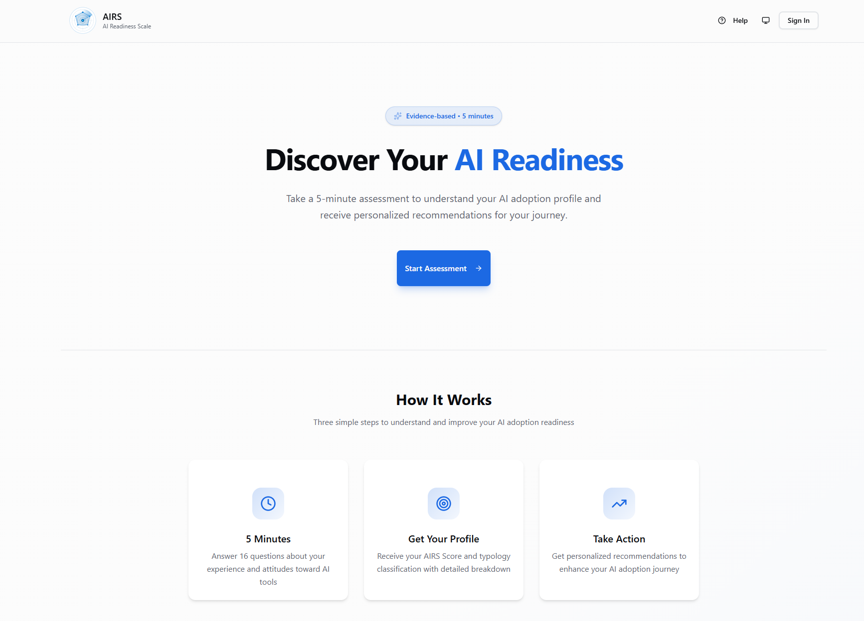
Findings

Slide 7
What Drives AI Adoption?
Three factors significantly predict AI adoption intention.
1. Value
2. Hedonic Motivation
3. Social Influence
β = .505, p < .001
β = .217, p = .014
β = .136, p = .024
"Is the value worth the cost/effort?"
"Is it engaging and enjoyable?"
"Do important others support AI use?"
The cognitive trade-off between benefits received and resources invested
Intrinsic satisfaction from using AI tools
Peer influence and organizational norms
Curiosity and stimulation drive continued engagement
AI champions and visible leadership matter
Includes time, learning curve, workflow disruption—not just money
Near-Significant:
AI Trust (β = .106, p = .064): Approaching significance—larger samples may confirm

Slide 8

Moderation Effects
Experience and population moderate AI adoption pathways.
Experience Moderation:
Population Moderation (Student vs Professional):
Interaction
β
p
Result
Path
Student β
Professional β
Δβ
p
HM × Experience
.136
.009
✅ Significant
HM → BI
+0.449
-0.301
-0.750
.041
PV → BI
+0.638
+0.808
+0.170
ns
PE × Experience
.112
.055
⚠️ Marginal
Key Insight:
Students: "Make it fun and I'll use it"
Professionals: "Show me the value and I'll use it"

Slide 9




Future Research Directions
Building on this foundation.
Longitudinal Studies
Construct Development
Track adoption trajectories over time
Multi-item scales for excluded constructs (3-4 items per dimension)
Examine how predictors change with experience
Validate AI Anxiety, Ethical Risk with expanded operationalization
Population Replication
Intervention Research
Cross-cultural validation
Test segment-specific interventions
Industry-specific applications (healthcare, finance, education)
Experimental validation of practical recommendations

